Slide 1

Introduction to Flutter
What is Flutter?
Dart?
Flutter vs Dart

Slide 2
Previous Dev. Platforms
App
web
Front-end
Back-end
Mobile
iOS
Android
HTML, CSS, JS
PHP, Node.JS, GO
Swift,
Objective C
Kotlin, Java
Desktop
Linux
Windows
macOS
C, C++
.Net
ObjectiveC
Swift

Slide 3
New concept Dev. Platforms
App
web
Front-end
Back-end
Mobile
iOS
Android
HTML, CSS, JS
PHP, Node.JS, GO
Swift,
Objective C
Kotlin, Java
Desktop
Linux
Windows
macOS
C, C++
.Net
ObjectiveC
Swift
(Flutter) DART

Slide 4
What is Flutter?
A “tool” that allows developer to build native application on iOS and Android platform with one programming language and codebase.
The application is “native cross-platform” application.
A SDK (Software Development Kit)
A Framework / Widget Library
Tools to compile your code to naitve machine code + develop with ease
Re-usable UI building blocks (= widgets), utility functions, packages

Slide 5

Dart?
Object-oriented & Strong Typed
Focused on frontend (mobile apps, web) user interface (UI) development.
Programming language developed by Google
Syntax is like a mixture of JavaScript, Java, C#
(not require to have skill on the languages)

Slide 6
Flutter vs Dart
Flutter Framework
A Framework (Set of Features)
A Dart Framework providing Utility Functions & UI Elements (Widgets)
Flutter
Dart
The Programming Language
Flutter SDK
A Set of Tools

Slide 7

Flutter Architecture

Slide 8
Outline
The layer model: The pieces from which Flutter is constructed.
Reactive user interfaces: A core concept for Flutter user interface development.
An introduction to widgets: The fundamental building blocks of Flutter user interfaces.
The rendering process: How Flutter turns UI code into pixels.
An overview of the platform embedders: The code that lets mobile and desktop OSes execute Flutter apps.
Integrating Flutter with other code: Information about different techniques available to Flutter apps.
Support for the web: Concluding remarks about the characteristics of Flutter in a browser environment.

Slide 9
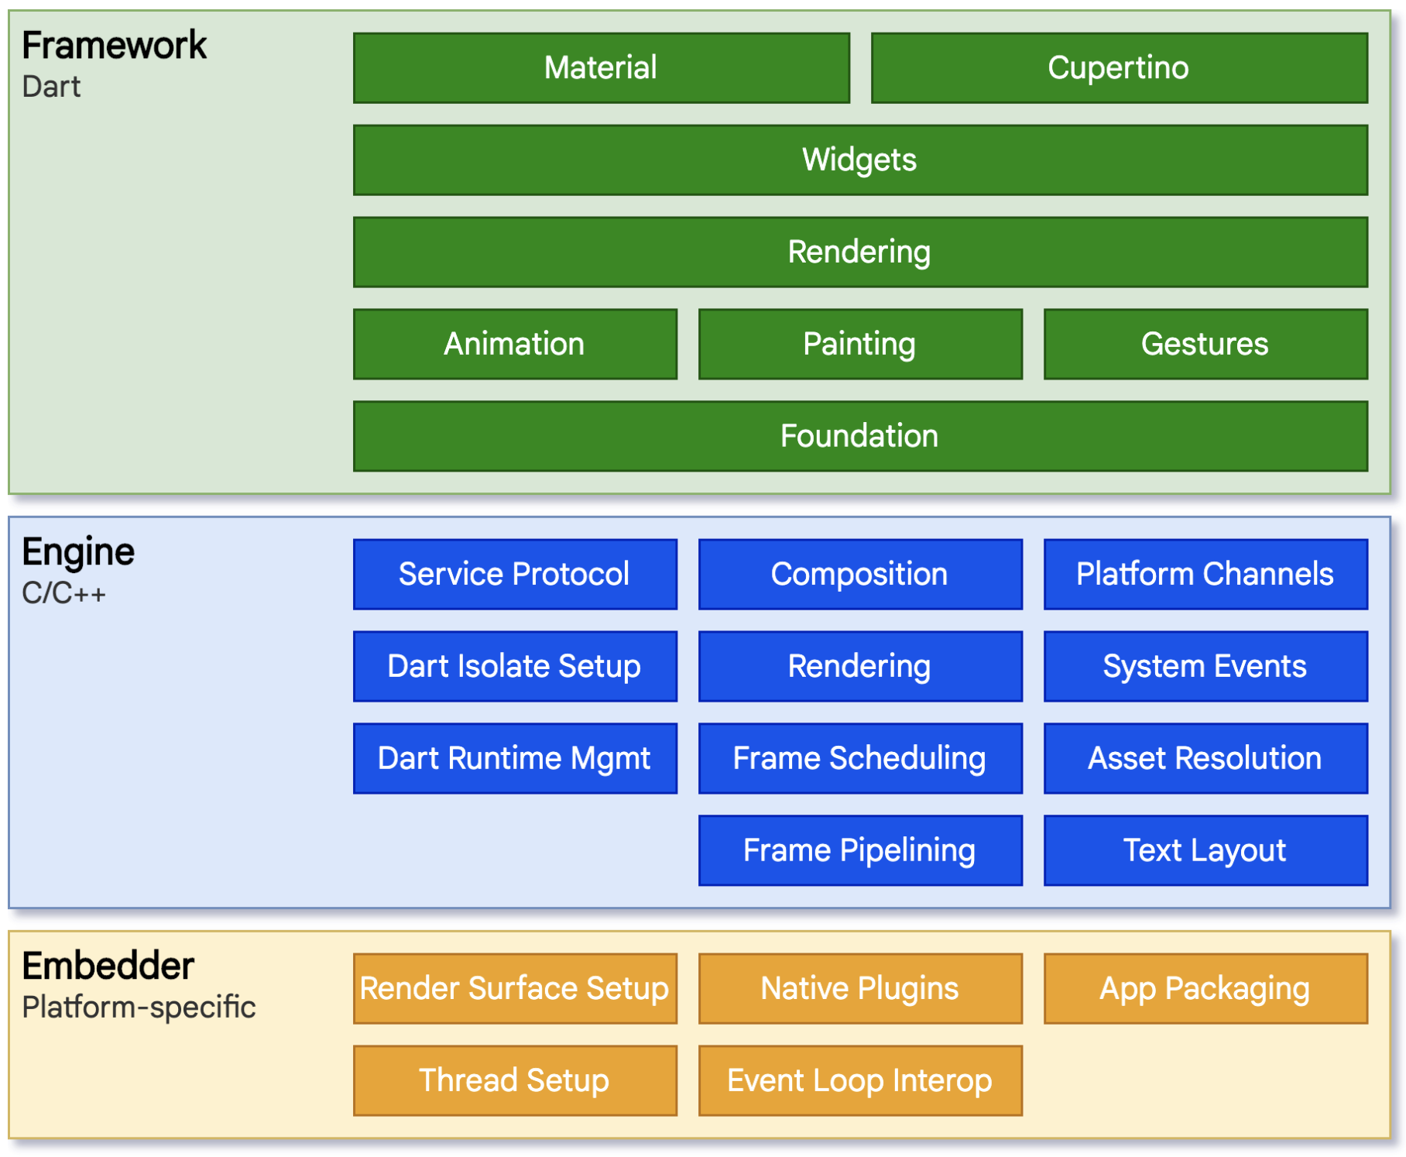
Architecture Layers
Basic foundational classes, and building block services such as animation, painting, and gestures that offer commonly used abstractions over the underlying foundation.
The rendering layer provides an abstraction for dealing with layout. With this layer, you can build a tree of renderable objects. You can manipulate these objects dynamically, with the tree automatically updating the layout to reflect your changes.
The widgets layer is a composition abstraction. Each render object in the rendering layer has a corresponding class in the widgets layer. In addition, the widgets layer allows you to define combinations of classes that you can reuse. This is the layer at which the reactive programming model is introduced.
The Material and Cupertino libraries offer comprehensive sets of controls that use the widget layer’s composition primitives to implement the Material or iOS design languages.

Slide 10
Reactive user interfaces
On the surface, Flutter is a reactive, pseudo-declarative UI framework, in which the developer provides a mapping from application state to interface state, and the framework takes on the task of updating the interface at runtime when the application state changes.
There are many places where the state can be changed: the color box, the hue slider, the radio buttons. As the user interacts with the UI, changes must be reflected in every other place.
A widget declares its user interface by overriding the build() method, which is a function that converts state to UI:
UI = f(state)

Slide 11
Widgets
Flutter emphasizes widgets as a unit of composition. Widgets are the building blocks of a Flutter app’s user interface, and each widget is an immutable declaration of part of the user interface.
Widgets form a hierarchy based on composition. Each widget nests inside its parent and can receive context from the parent. This structure carries all the way up to the root widget (the container that hosts the Flutter app, typically MaterialApp or CupertinoApp), as this trivial example shows:

Slide 12
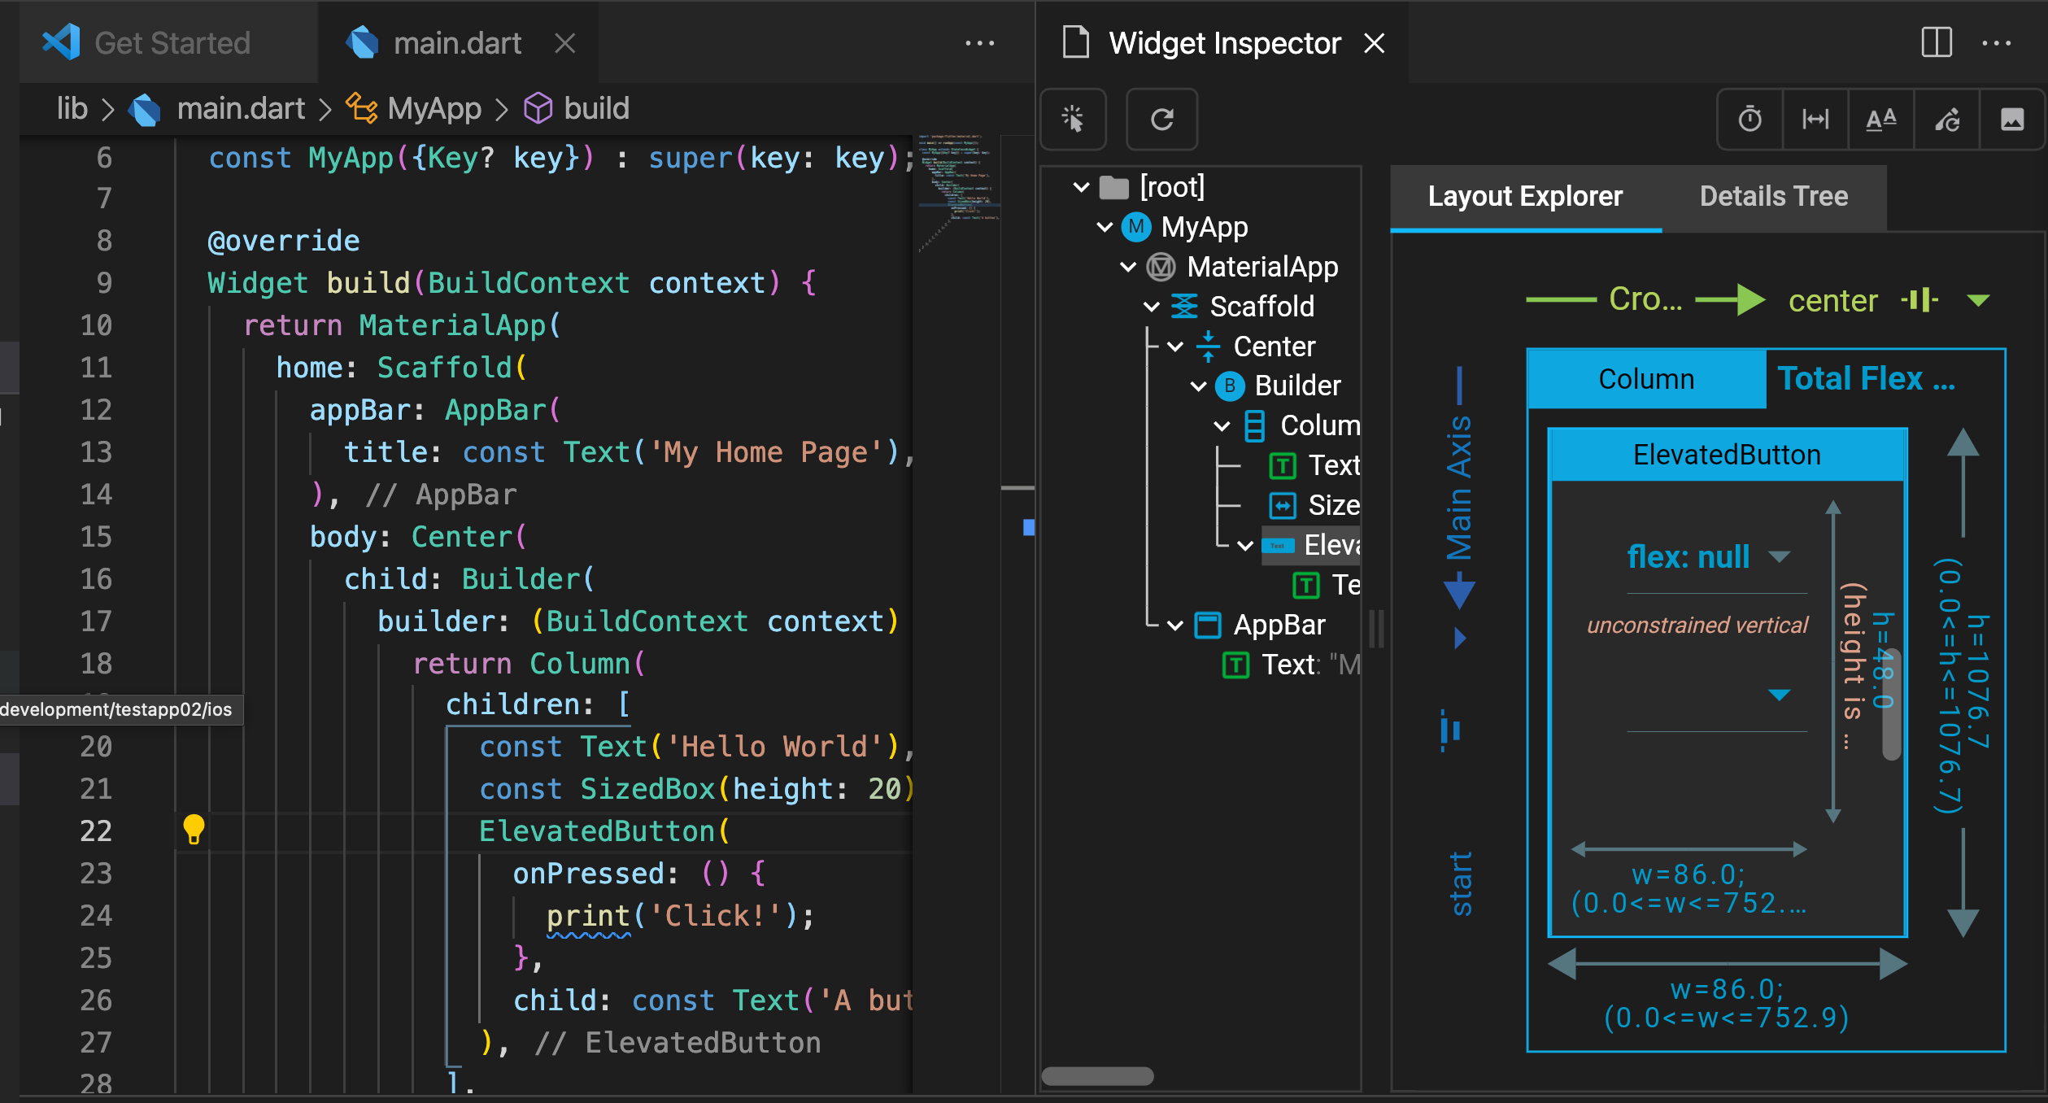
import 'package:flutter/material.dart';
void main() => runApp(const MyApp());
class MyApp extends StatelessWidget {
const MyApp({Key? key}) : super(key: key);
@override
Widget build(BuildContext context) {
return MaterialApp(
home: Scaffold(
appBar: AppBar(
title: const Text('My Home Page'),
),
body: Center(
child: Builder(
builder: (BuildContext context) {
return Column(
children: [
const Text('Hello World'),
const SizedBox(height: 20),
ElevatedButton(
onPressed: () {
print('Click!');
},
child: const Text('A button'),
),
],
);
},
),
),
),
);
}
}

Slide 13

End of Session
Answer the short questions

